Slide 1
Introduction to eFACTS Logging 2014-03-28
Martin Svennungsson/Jonas Qvist/Markus Löfgren/Jean-Philippe Abeillon
Notes:
JPA – additional changes:
Replacement of Volvo 3P by Volvo GTT

Slide 2
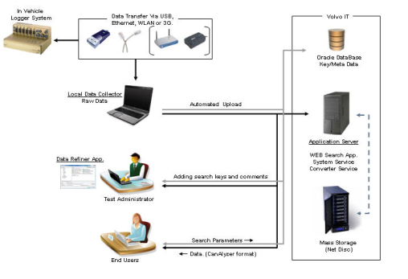
Agenda
Background
What is Truck Function Validation ?
Way of working (Yesterday/Today)
The data logger
How to use the logger system
Installations
How to handle logged data
Data Management Applications
Demo of applications
(PC installations)

Slide 3
Evolution of the E/E-Architecture
Standalone ECUs
Function specific ECUs
Signals shared via splicing
TEA
Linked ECUs
Single BUS system
Function specific ECUs
TEA2
Multi Function ECUs
gateway
Radio
climate
ReLi.Sens.
Engine
Heterogeneous BUS system
Central Gateway
Integrated ECUs
Navigation
PTC
wiper
Transmission
AMP
Dome Lamp
door driver
ABS/ESP
TEA2+
phone
Seat driver
door passenger
4WD
TV
Seat passanger
Rear door right
EPS
PDC
Rear door left
Airbag
ACC
Cluster ECUs
Powertrain CU
Chassis CU
Cabin CU
Infotainment CU
Backbone BUS
Decentraliced Gateways
Intelligent Sensors/Actuators
EMS
TPM
HFAC
radio
brake
BMS
door module
IP
transmission
level control
cab extension
AMP
retarder
DAS
access control
phone

Slide 4
Architectural Differences
TEA2
TEA2+
Vehicle Architecture
The J1587 data link has reached its limitation.
No support for old platform component from suppliers
Not an industry std.
Very slow SWDL (not meeting GM/AM reqs)
Limitations for added functionality.
Pass Through
Infrastructure
Cab Architecture
Centralised EE architecture in CAB (IC, LCM)
All Switches Hard wired (~5pins/switch)
Two pass through (~600 pins)
Chassis architecture
Sensors and actuators on chassis
W/H routed on both right and left (mixed with pneumatics)
Manufacturing
Current product is not modularized and the assembly has a huge complexity in the area of clipping and routing
Every truck are more or less unique and the assembly quality is to a very high extent operator dependant
Vehicle Architecture
J2284 500kbit Volvo proprietary net (CAN)
Separation of infrastructure and application (Autosar)
Following industry standards and interfaces
ISO Diagnostics, Std protocols, A-interfaces GIC
Cab Architecture
Distributed EE architecture in CAB (Gateways)
Flexible Switch concept (3pins per 4 switches)
One pass through (155pins)
Chassis Architecture
ECUs on chassis
Less W/H part no and less terminals
W/H always mounted on the right side of the frame, avoiding mixing with pneumatics
Manufacturing
Modularized product with easier clipping and routing
Assembly time. Faster communication needed to reduce assembly time. Since software sizes will increase this will be even more important
Notes:
JPA – minor typing modifications
Additional changes – “Add-on differences”
New enhanced diagnostics (supporting new demands of Soft offers, due to enhanched diagnostic capabilities)
New aftermarket tools (improved GD)
New power management strategy (enhanced battery lifetime, optimized power consumptions in different vehicle modes)
New communication strategy (faster SWDL, allowing distributed system to be able to modularize the EE architecture)
New processes and development tools (to have a faster time to market, and portability)

Slide 5
Add-on Features with TEA2+
New Enhanced Diagnostics
Support of new Soft Offer demands thanks to enhanched diagnostic capabilities.
New aftermarket tools (improved GD)
New Power Management Strategy
Enhanced batteries lifetime
Optimized power consumption thanks to several vehicle modes
New communication strategy
Faster Software downloads
Allows distributed system to be able to modularize the EE architecture
New processes and development tools
Faster time to market
Portability
Notes:
JPA – New slide

Slide 6
TEA2 Architecture
LCS
SA:174, MID:204
ACC Radar
SA:42, MID:219
LPS
SA:232, MID:248
ISO 11992-2
Trailer connection
J1939-6
ESP
CAN-4:
SAE J1939
J1939-8
EBS
BBM
SA:230, MID:249
ABS-F
B-builder
DACU
SA:173, MID:238
ABS-B
SA:11, MID:136
LCM
SA:55, MID:216
ECS
SA:47, MID:150
CAN-EXT:
SAE J1939
J1708/J1587
FMS-GW
SA:37, MID:179
J1939-1
EMS II
SA:0 (15), MID:128
VECU
SA:17, MID:144
GSECU
SA:5, MID:223
RECU
SA:16, MID:222
Cluster
SA:23, MID:140
Alarm
MID:214
J1939-7
SCR
J1939-2
TECU
SA:3, MID:130
RAS
SA:56, MID:184
Audio
SA:76, MID:206
IMMO
MID:163
ADS
SA:61, MID:233
Tachograph
SA:238, MID:220
NOX
SA:81
ALCOLOCK
SA:-
TECU/GSECU for
- AMT-C
- PowerTronic
J1939-3
SRS
MID:232
NOX
SA:82
Phone
SA:74, MID:231
T-GW
SA:65, MID:141
STD
UQS
SA: 163
MCC
USB
TPM
SA:51, MID:166
ECC
MID:146
TTU
MID:203
EGR
VCADS
MID:172
VGT SRA
SA: 2
OBD scan tool
SA:249, 250
Notes:
Centralized functional allocation
Little segmentation
All communication via backbones,
SWDL, Diagnostic and some functional signals on J1587
Primarily functional data on 1939

Slide 7
TEA2+ HD COE Architecture
Notes:
Distributed functional allocation
Network is segmented into several sub-nets, e.g. chassis
Efficient utilization of communication bandwidth and harnesses
Only “necessary” communication on backbones, feature communication on subnet i.e a segmentation.
Gateways
Connects the main network segments
Performs routing
Provide a central diagnostic connection
Cooperation with suppliers on complete sub-nets
Minimized need for coordination resources from PD

Slide 8
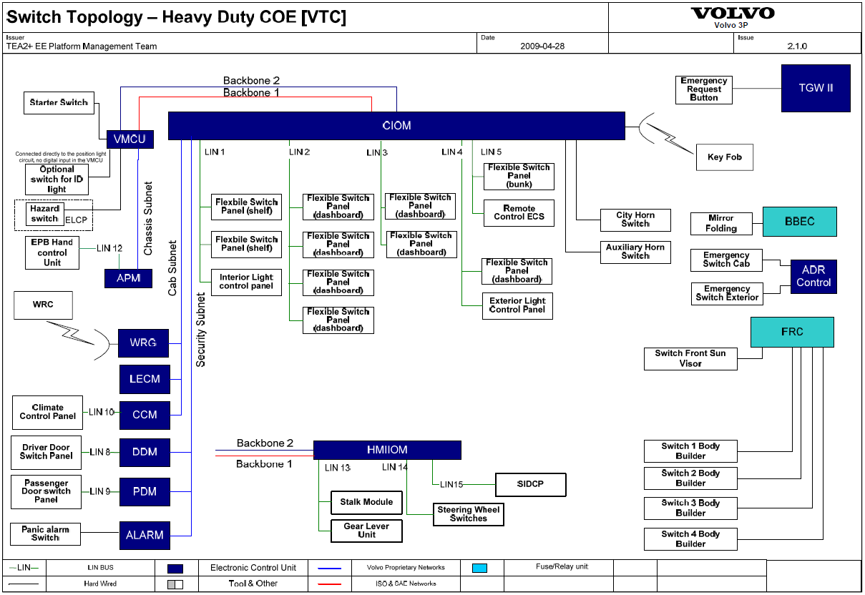
LIN (Local Integration Network)

Slide 9
”Truck Function Validation” Background
Historically, Complete Vehicle / FVV has focused on mechanical testing.
For the new electrical architecture TEA2+, a new structured way of working is needed to include EEE in the complete vehicle testing from a driver perspective.
Earlier, no logging was made when a electrical faults appeared. You have simply reported the error in Protus and left to EEE to handle the fault tracing.
The lead time for solving electrical problems needs to be shortened.
Occasional errors are hard to recreate. Logging always needed.
Earlier, electrical testing has mostly been ”happy testing”.PVT testing and integration of electrical testing in RT/AET/FT codes needed.

Slide 10
What has Truck Function Validation accomplished?
New test code - Performance Validation Test (PVT)
Translated functional specifications into test code.
Tested PVT and logger equipment in vehicle.
Updated the test codes for RT/AET/FT
Provided a new data logging system including:
New hardware
Developed a ”back office” solution for data management.
New way of storing data files (cheaper)
Upgraded Protus to support web-links
Improved the network against EEE
Ensured TEA2+ education for CV
New TeamPlace

Slide 11
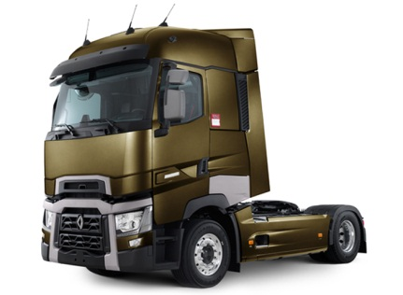
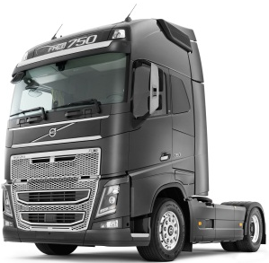
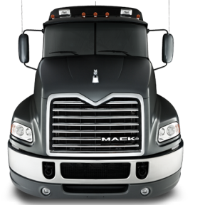
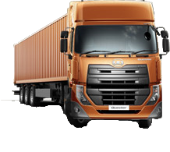

Old way of working
Software update
In vehicle fault tracing
(not always successful)
”I got a problem !”
PROTUS
No logged data
EEE Rescue Team
Notes:
JPA – addition of RT trucks

Slide 12
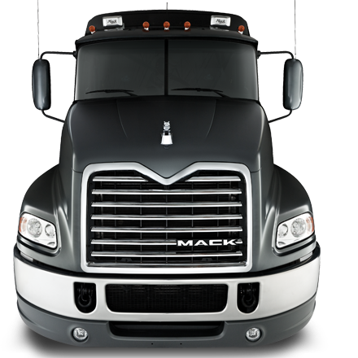
The new way! RT/PVT/FT (AET)
Update
Logged data
CAN trafic, Audio / video, GPS, snapshot
SW Release Function Package FP
I have logged an error !
The driver perspective!
QUEST/ (EEE)
PROTUS

Slide 13
Why do we need a new system?
Then:
Earlier, measurements have been focused on separate functions.
You have known which signals to log.
The functions have been more or less unique for each ECU.
Now:
We don’t know which errors that will appear = we don’t know what to log.
Functions distributed over several ECU’s = we don’t know which data buses to connect to.
We don’t always know what is the cause and effect = we don’t know which signals to log.
Conclusion:
Connect everywhere and log everything!
Consequence:
Large amount of data that have to be sorted by fault types and made accessible to the end users.
Solution:
1. New logging equipment that meets the new demands.
2. New ”Backoffice” solution for data management.

Slide 14
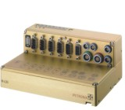
DEMO

Slide 15
System Installations
Must have:
Breakout cables CAN
Power cables +24V, Gnd, ignition
What to connect ?
CAN, Power
Place the microphone + GPS (+ video)
To verify the installation CANalyzer is needed.
To test the installation on a later stage, use CVEL_MLOG_Tester.
Run the application on the USB-stick to verify CAN-traffic (CVEL_MLOG_Tester) – if you have log files from several loggers you have to choose which logger to test It is always the latest log file that is being cheked, snapshot data included.
Regarding video, use the PC to configure the camera.
NOTE: You have to register in the database in which vehicle the logger is installed. Use the Collector application the configure.
In a near future this action becomes obsolete. The logger will read information from vehicle.

Slide 16
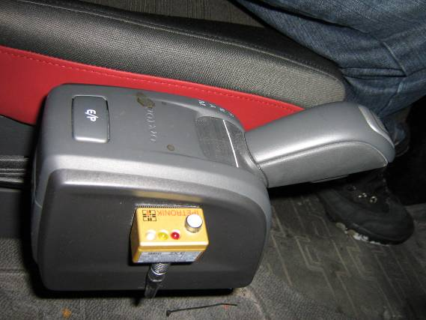
How to start the logger manually?
The microphone LED shows a blue light → system is ready
An error occurrs → the driver presses the button→ logging starts → LED shows a yellow light
Traffic is logged on up to 12 CANbuses (25 s BEFORE and 15s to 2 min AFTER the button is pressed)
Audio Commentary is recorded 15s-2 min AFTER the button is pressed
Video/picture (e.g. cluster/road information), 10s before button is pressed and 15s to 2 min after.
Trigger start button
Yellow light– logging in progress
Microphone
/!\ Wait 1 minute between 2 successive logs
Pressing the button while yellow LED extends recordings

Slide 17
How to turn off the vehicle?
The logger is activated when ignition is turned on.
The logger closes down 30 s AFTER ignition off.
The microphone LED quickly flashes red/blue when packing files.
WAIT until no microphone LED light is turned on, before you turn off the vehicle main power switch/lock with the remote.
In effect, wait about 30 s after you have switch the ignition off.
This is a general rule for all measurement systems.

Slide 18
How to transfer data from the logger using a USB memory stick?
I possible, only use CORSAIR Voyager USB-memory (16GB)
They have a faster transfer rate, recommended by the supplier.
Insert the memory stick.
Look at the microphone LED
It will change from blue to red and after a while flash fast between red and blue (the data is being zipped)
It will change from blue to red and after a while flash slowly red and blue (the data is being transferred to the stick)
NOTE ! No data remains in the logger ! (configurable)
After the LED showed STEADY red light at least 10 s, the transfer is ready. Check also that the USB stick LED is off.
Pull out the memory stick
The LED will turn blue again.
If nothing happens when the stick is inserted, check the extension cable!

Slide 19
How to get data from several loggers?
You can get data from several loggers in the same way as one.
The data structure on the USB-stick will be:
8000xxxx
8000yyyy
8000zzzz (one folder per M-LOG datalogger serial number)
You can also provide the stick with a security key – without the right key you are not able to transfer data.
(If you want to change the logger configuration you can use the memory stick.).

Slide 20
Extra: Log file structure
8000xxxx
DATA
LOGxxx.zip (information about the device, a new file is created for every ignition on/off, always remains)
MEAxxx.zip (a new file is created for every ignition on/off, only remains if there is logged data)
Traffic (one for each event)
Audio (one for each event)
Video (one for each event)
Data (”external data” or snapshot data)
DEVICE
Current configuration
Volvo GTT Martin Svennungsson / Jonas Qvist / Markus Löfgren / Jean-Philippe Abeillon
Notes:
Slide 23 removed because it is already present in the EFACTS education Presentation

Slide 21
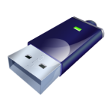
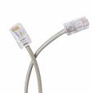
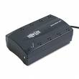


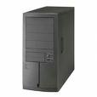


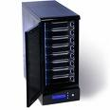

CVEL Data System
In Vehicle
Logger System
Data Transfer Via USB,
Ethernet, WLAN or 3G.
Volvo IT
Oracle DataBase
Key/Meta Data
Local Data Collector
Raw Data
Automated Upload
Application Server
WEB Search App.
System Service
Converter Service
Data Refiner App.
Adding search keys and comments
Test Administrator
Search Parameters
Mass Storage
(Net Disc)
End Users
Data. (CANalyzer format)

Slide 22
My responsibilities as TE/TL
Check/update - logger/vehicle binding in Collector
Transfer the data from the logger to the server.
Check-in Events to the database with appropriate keys attached. 30 day limit from when event was recorded!!
Discard non-valid Events
Link the data to a PROTUS report.
Volvo GTT Martin Svennungsson / Jonas Qvist / Markus Löfgren / Jean-Philippe Abeillon

Slide 23
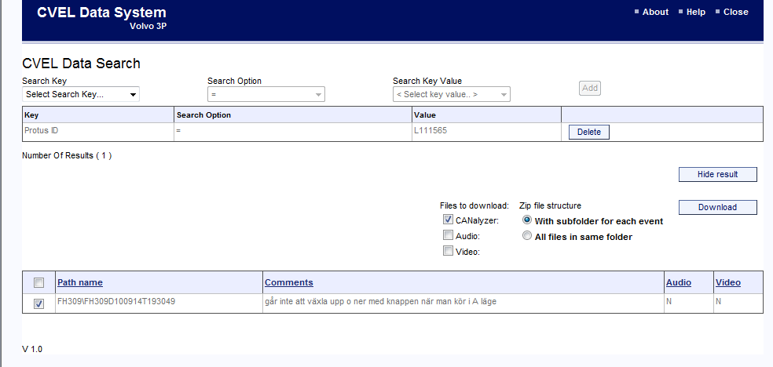
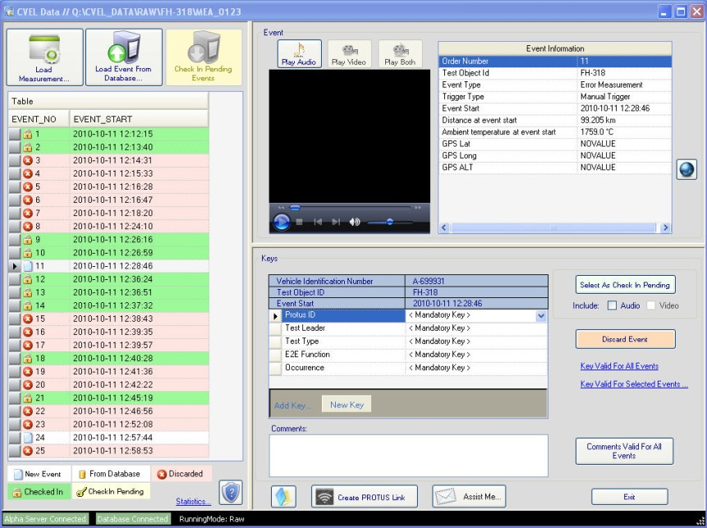
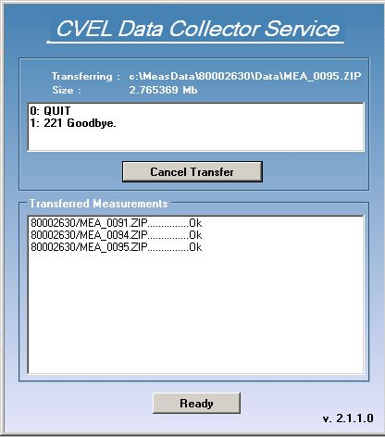
Application Demo
Volvo GTT Martin Svennungsson / Jonas Qvist / Markus Löfgren / Jean-Philippe Abeillon

Slide 24
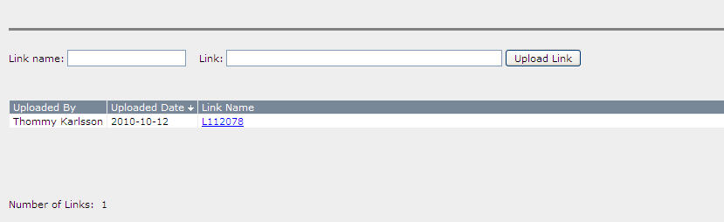
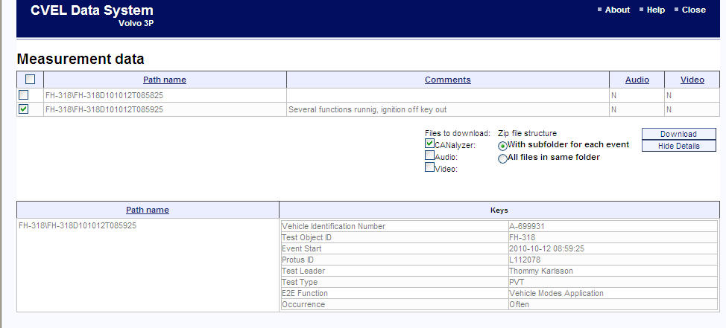
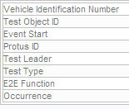
PROTUS link
Encrypted PROTUS Id
http://cveldata.got.volvo.net/Default.aspx?ProtusGUID=7d521104-a737-4e68-9f74-924d098b0a4b

Slide 25
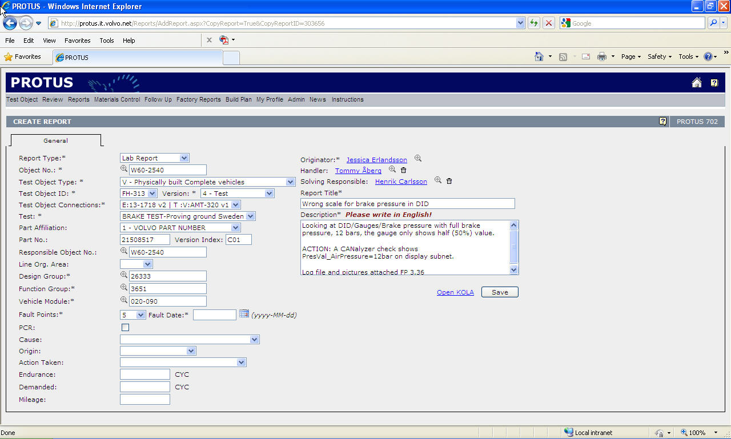
PROTUS

Slide 26
Work flow - repetition
Upload data from logger
Check Logger/Vehicle binding in Collector
Copy data from USB to C:\MeasData (everything incl 8000xxxx)
Also save a copy somewhere on your local HDD
Wait until all data on USB is in the MeasData folder
Upload data to server using Collector (Transfer window)
Note! Transfer rate, when working outside Volvo
”Show Log-file..” (if correct MEA_xxxx and usually LOG_xxxx)
Refine data –(add metadata+Check-in) or Discard, using Refiner
Create PROTUS link in Refiner, identical info in PROTUS id as you entered, when creating the link
Upload the link in PROTUS
Check that the PROTUS link works.

Slide 27
Future Developments
Readout of the vehicle id (VIN)
Diagnostics readout
Remote communication (WLAN)
”Hotspots”
Display
RT-testing (brake temp/warning, …)
Multiple LIN
Readout of the ECU HW/SW id
Remote communication (GPRS/3g)
Transfer data
Change configuration
Futher camera implementations
Max 4 , against the light, darkness

Slide 28
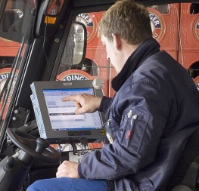
Future Workflow
Test Sequence
eFACTS Refiner
PVT Manager
Import Test Sequences
Export Results
Editing Test Cases
Managing Test Sequences
Creating Reports

Slide 29
PC Prerequisites
”Open Client” for myPlace computers (FAROS)
First mail to Martin (GOT users)
When confirmed, use motivation sent by Martin (GOT users)
Oracle client version 11 or newer (FAROS)
Contact TFV team for installation or use
eFACTS Data Refiner
eFACTS Collector
CVEL USB Applications (if needed)
CVEL_Data_Copy, CVEL_MLOG_Tester, CVEL_USBauto

Slide 30
Introduction to eFACTS Logging
Questions? Mail to: support.efacts@volvo.com
Logger problem (GOT): +46 31 32 73090
https://teamplace.volvo.com/sites/3p-EEE-CV/default.aspx

